Slide 1
IP Address
An IP address, short for Internet Protocol address, is an identifying number for a piece of network hardware.
Having an IP address allows a device to communicate with other devices over an IP-based network like the internet.
Internet Protocol version 4 (IPv4)
An IPv4 address is a 32-bit address that uniquely and universally defines the connection of a device (for example, a computer or a router) to the Internet.
Connectionless protocol
Fragments (divides) packets where necessary
Addressing via 32 bit Internet addresses
It is one of the core protocols of standards-based internetworking methods in the Internet, and was the first version deployed for production in the ARPANET in 1983

Slide 2
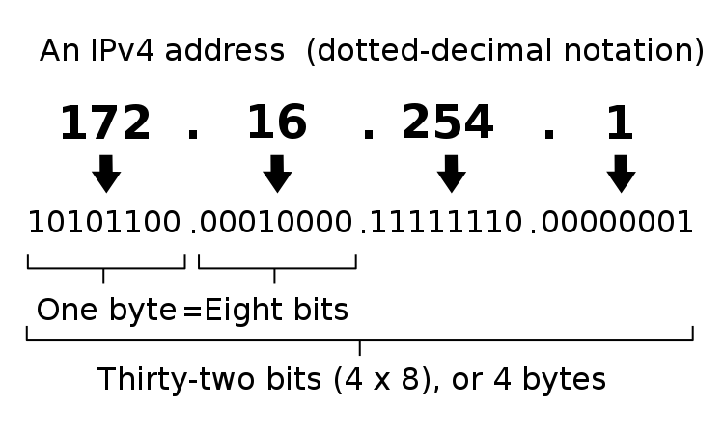
octets
In computer and network technology, an octet represents any 8-bit quantity. Octets range in mathematical value from 0 to 255.
Octet strings are most commonly found in Internet protocol (IP) addressing , in which the 4 bytes of an IPv4 address consists of 4 octets. In dotted-decimal notation, an IP address appears as follows:
[ octet ] . [ octet ] . [ octet ] . [ octet ]

Slide 3
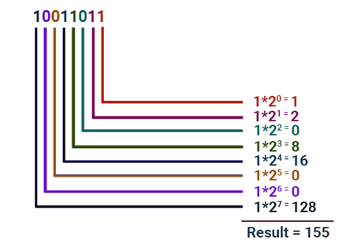
Binary to Decimal Conversion

Slide 4
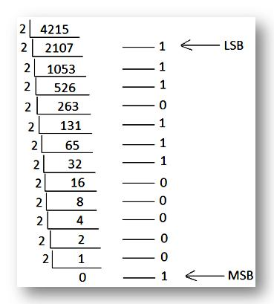
Decimal to Binary Conversion
4215 = 1000001110111

Slide 5
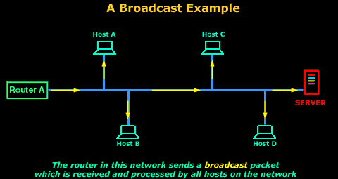
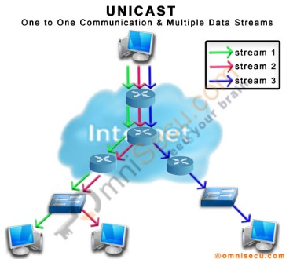
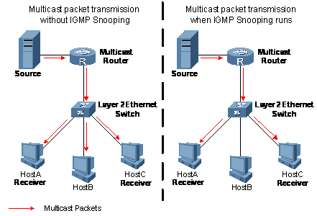
Types of Communications
In ipv4 network host can communicate in three different ways :
Unicast –the process of sending a pocket from one host to an individual host
Broadcast- the process of sending a packet from one host to all the hosts in the network
Multicast – the process of sending a packet from one host to a selected group of hosts

Slide 6
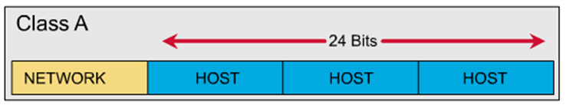
Ipv4 address classes
There are 5 address class in ipv4
Class A
class A address uses 8 bits for the network Address and 24 bits for host addresses.
It as 128 networks and 16 million hosts.
The IP address start from 1.0.0.0 to 127.255.255.255
Ip address uses first octet for network address and remaining three octets for host addresses
Default subnet mask is 255.0.0.0

Slide 7
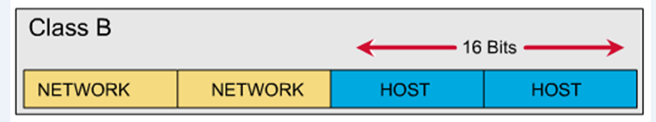
Class B
class B address uses 16 bits for the network Address and 16 bits for host addresses.
It as 16,382 networks and 65,534 hosts.
The IP address start from 128.0.0.0 to 191.255.255.255
Ip address uses first two octet for network address and remaining two octets for host addresses
Default subnet mask is 255.255.0.0

Slide 8
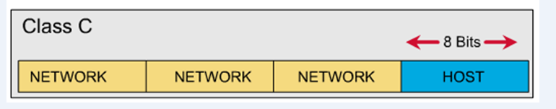
Class c
class C address uses 24 bits for the network Address and 8 bits for host addresses.
It as 2 million networks and 254 hosts.
The IP address start from 192.0.0.0 to 223.255.255.255
IP address uses first three octets for network address and last octet for host addresses
Default subnet mask is 255.255.0.0

Slide 9

Class D
The class D address class was created to enable mulcasting in an IP address.
A mulcasting address is a unique network address that directs packets with that destination address to predefined groups of IP addresses.
Therefore , a single station can simultaneously transmit a single stream of data to multiple recipients.
Range 224-239
1110
Host portion
Class E
These class address is used for only Research and Development.
Range 240-255
1111
Host portion

Slide 10
The IP address can be classify into two classes:
Public address:
This address considered as any valid address assigned to any user, and the organization who is responsible for registering IP ranges called Internet Service Providers (ISPs), and this address will be unique.
Private Address:
Any number or address assigned to a device on a private TCP/IP Local Area Network that is accessible only within the Local Area Network.
RFC1918 designates three ranges of IP addresses as private:
10.0.0.0 through 10.255.255.255
172.16.0.0 through 172.31.255.255
192.168.0.0 through 192.168.255.255

Slide 11
Internet Protocol version 6 (ipv6)
Maintains good features of IPv4, discards bad ones.
• Not compatible with IPv4
• Compatible with all other Internet protocols including
TCP, UDP, ICMP, DNS, etc.
Main features:
Long addresses (128 bits) ⇒ supports billions of hosts.
Simplified, fixed size header ⇒ routers can process packets faster.
Support for authentication and privacy
Better support for type of service.

Slide 12
Addressing without Subnets
If we have a class B with a Flat Network, the number of host will be more than 216=65536 hosts,
So the problem is here, that managing this network with this number of host is too tricky and the
problems of this network will get down because of the heavy load. In other word, any single
broadband can slowdown the network.
Therefore, the solution is the subnetting. Subnetting means divide or separate the single network into multiple networks that can reduce the loading from one network.
The advantage of using subnetting is:-
1. Reduce the traffic and the increase the performance.
2. The smaller network can easier to manage.
As the number of distinct local networks grows, managing them become a serious headache. Every time a new network is installed the system administrator must contact NIC to get a new network number.
The solution to the problem is to allow a network to be split into several independent parts for internal use but still act like a single network to the outside world. In the internet literature these parts are called subnets.

Slide 13
Subnet Mask
A mask is a 32-bit binary number that is expressed in dotted decimal notation. By default, a mask contains two fields, the network field and the host field. These correspond to the network number and the locally administered part of the network address. When an administrator subnets, they are adjusting the way they view the IP address.
Table 1: Default masks for classful addressing

Slide 14
Routers and hosts still assume class subnet masks by default:
Class A /8 255.0.0.0
Class B /16 255.255.0.0
Class C /24 255.255.255.0
The figure below gives an example to class C mask address:

Slide 15
Subnetting
Example: 192.168.1.0/26
here address start with 192 , so it is in class C .By seeing the first octet we can decide which it is.
Default subnet mask for class C is 255.255.255.0
in binary 11111111.11111111.11111111.00000000
/26 = 111111111.11111111.11111111.11000000
26
For 26 network bits we have borrowed two host bits as shown above
so now subnetting subnet mask will be 255.255.255.192
11111111.11111111.11111111.11000000
64 is the lower bit

Slide 16
11111111.11111111.11111111.11000000
No of subnet borrowed = 26-24(default class C)=2
No of Subnet Address =2^2 =4
No of host remaining =8 (default)-2 (subnet)= 6
No of Host Address possible =2^6=64
Network address | First host address | Last host address | Broadband address
192.168.1.0 | 192.168.1.1 | 192.168.1.62 | 192.168.1.63
192.168.1.64 | 192.168.1.65 | 192.168.1.126 | 192.168.1.127
192.168.1.128 | 192.168.1.129 | 192.168.1.190 | 192.168.1.191
192.168.1.192 | 192.168.1.193 | 192.168.1.254 | 192.168.1.255

Slide 18
Testing of network Layer
1)Write in command prompt ipconfig
There will be three errors
Error 1 : windows IP configuration (NIC disabled)
Error 2: Media state disconnected (physical cable is not connected
Error 3: APIPA (configure manual IP address given by the ISP
2) Ping to modem IP –if it is okay then
3)Ping to DNS IP –if connection between isp and pc also okay then
4)Ping to websites
5) Check the pc :Security setting ,proxy setting and Disable the Proxy

